Slide 1
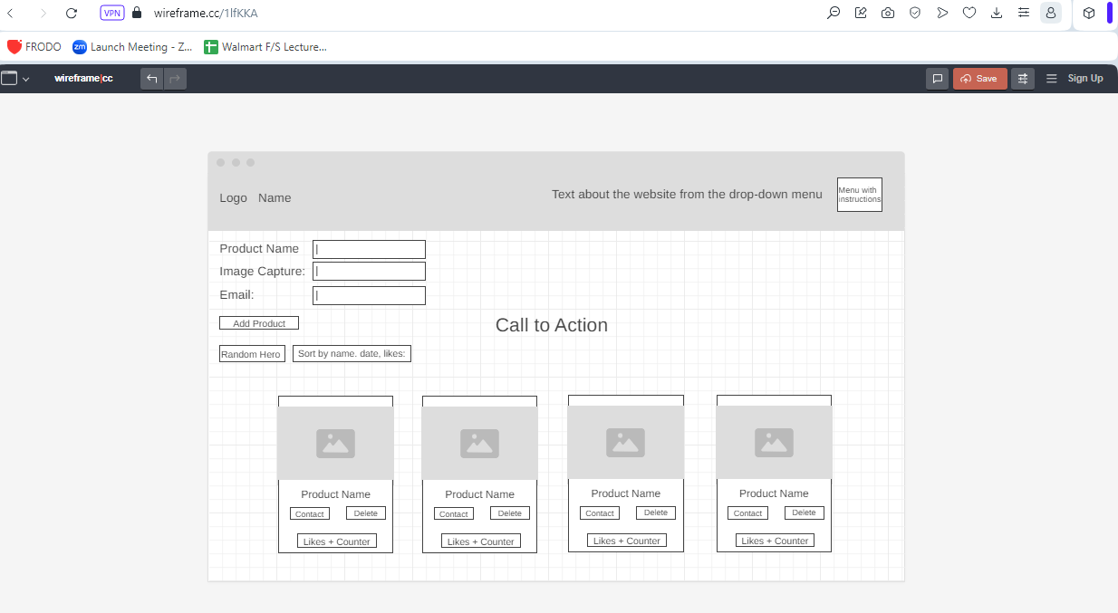
Captures New Product
Product Card Content:
Product Image
Product Name
2 buttons: Contact User and Delete
Number of Likes + Counter Likes
Adds Product
Selects Random Product from the List of Available Products
Sorts listed products by name, date or likes

